Slide 1
Correlation Between Food Price Inflation and Undernourished People in South East Asia

Slide 2
Reasons of large fluctuations in food prices in 2020 and 2021 in most countries.
The disruption of food supply chains in production and distribution of food worldwide,
The economic downturn due to COVID-19 induced a rise in the cost of imported food, amplifying the fluctuation in food prices.
The recession caused by the restrictions and lockdowns due to COVID-19 led to job losses and reduced income.
The conflict of Russia Ukraine pushed international prices further up.

Slide 3
Dataset
https://www.fao.org/faostat/en/#data/FS
https://www.fao.org/faostat/en/#data/CP

Slide 4
SEA countries
Timespan: 2002–2021
Food price inflation
Percentage change of undernourished people

Slide 5
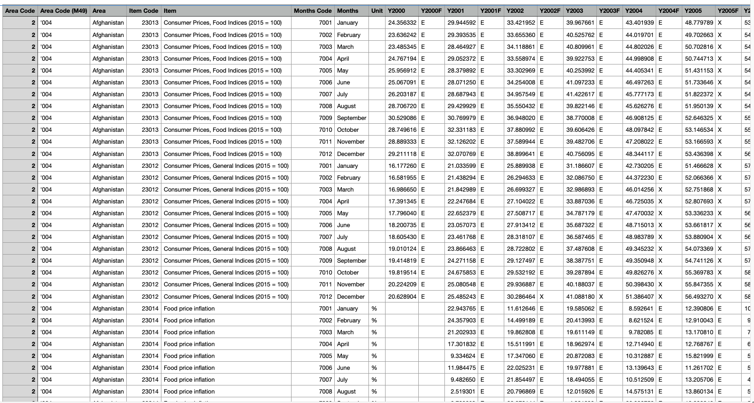
Notes:
Data consumer price, before cleaned

Slide 6
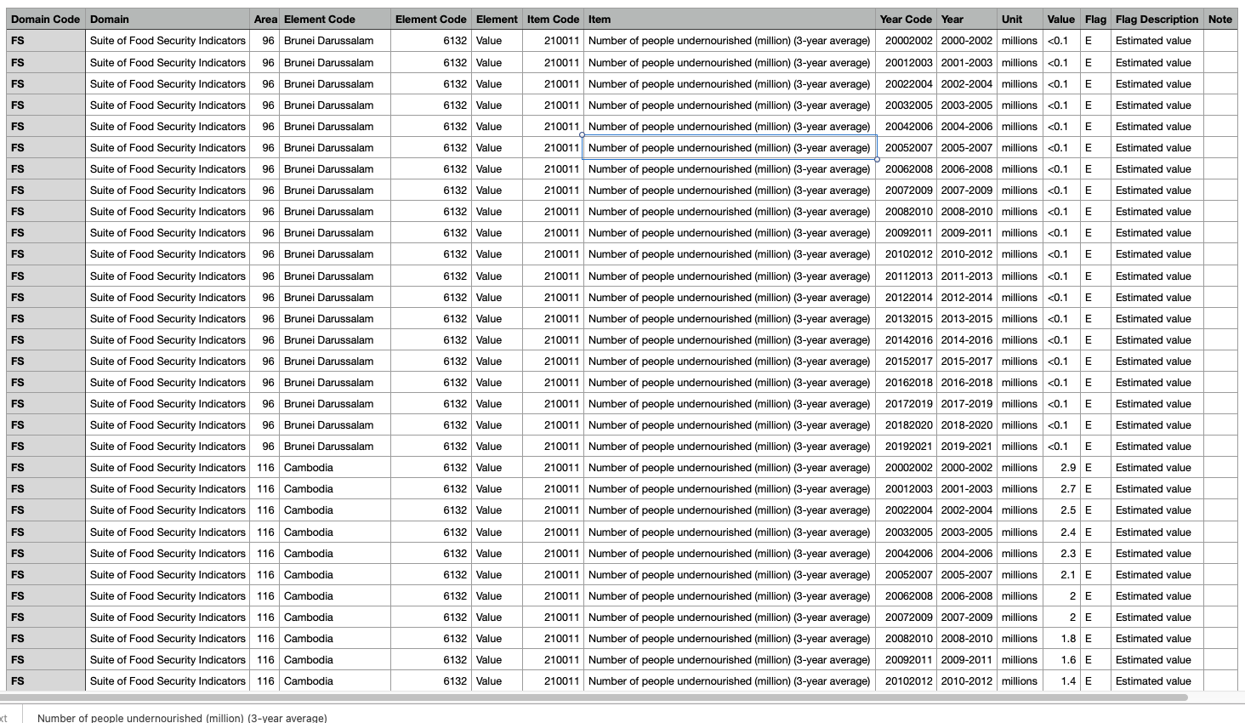

Slide 7
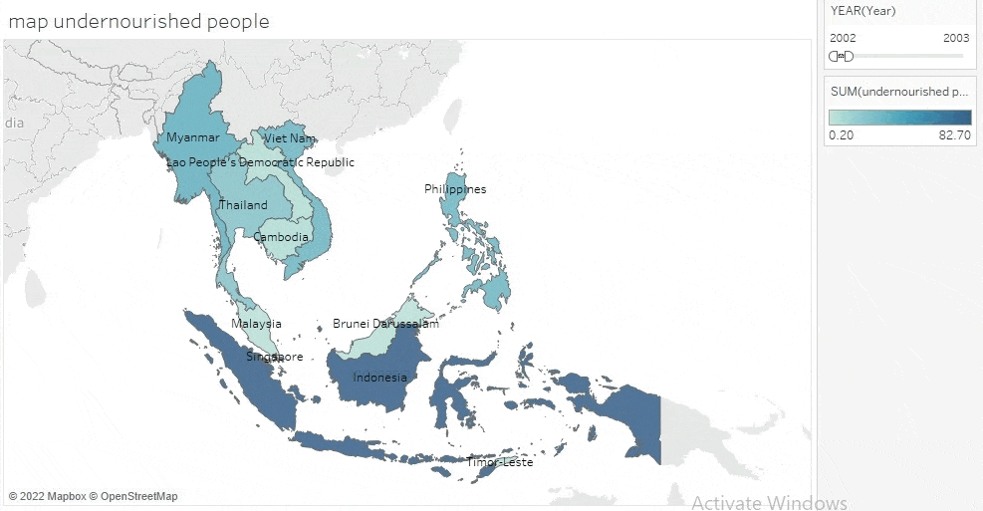

Slide 8
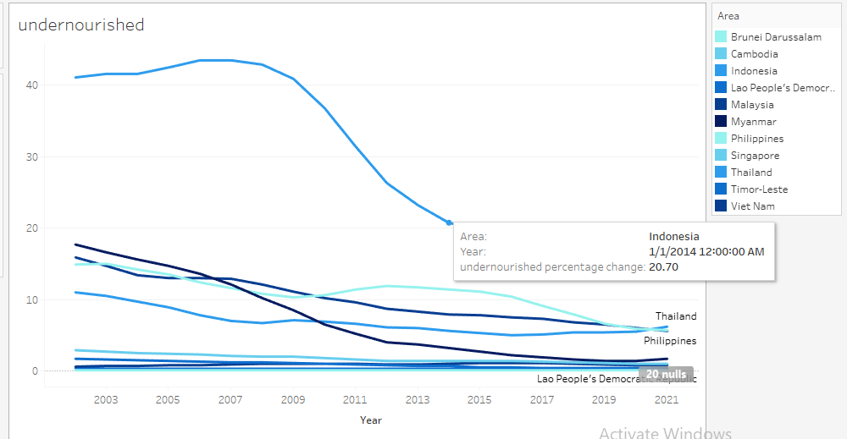
Undernourished curve

Slide 9
Undernourished curve shows the ratio change of the amount of unnourished people throughout the year
This visual shows that has the largest amount of unnourished people while Singapore and Brunei Darussalam have no or do not state the amount of unnourished people. However, through time, the amount of unnourished people generally decreased. Even though there were pandemic from 2020 to 2022, the effect of it can be ignored.
.

Slide 10
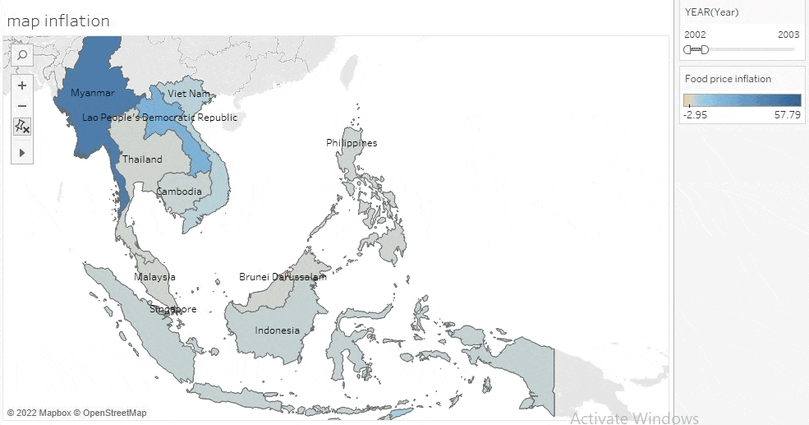

Slide 11
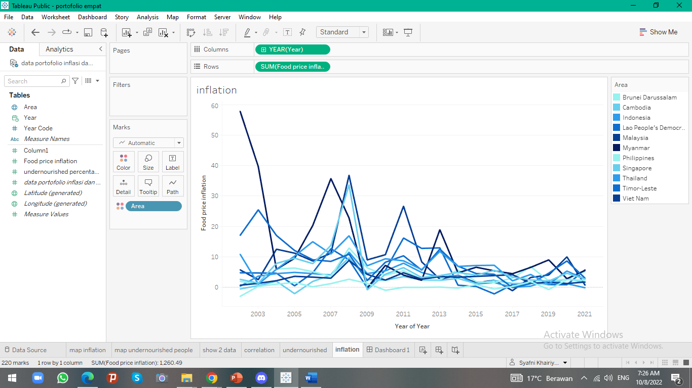
Food price inflation curve

Slide 12
Food price inflation shows the general ratio food price change throughout the year. This curve show the average yearly of food price change yearly from original monthly dataset.
From graphic, it shows that Myanmar is the most fluctuated country than others through 10 years. Even though pandemic really hit most of countries hard, evidently, pandemic does not give that much impact to food price either.
Among Asean countries, Brunei Darussalam is the most stable in term of food price and also the amount of unnourished people.

Slide 13
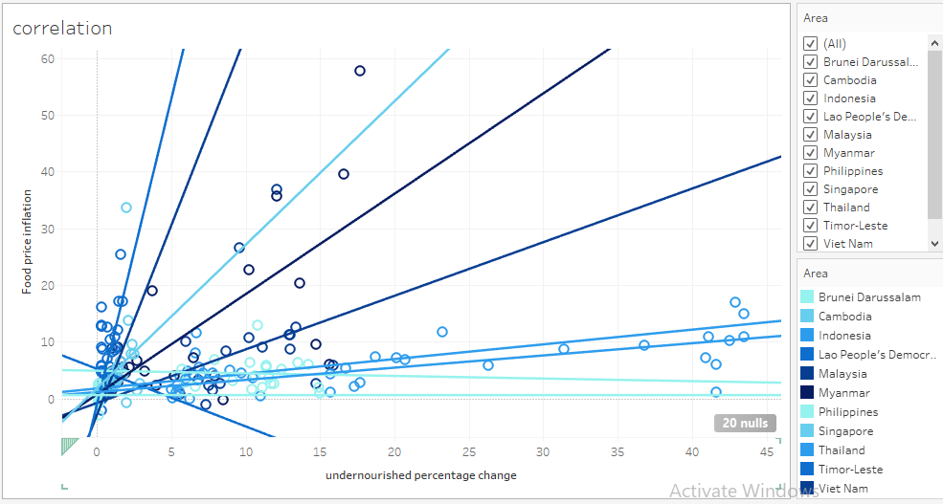
The correlation of food price inflation and amount of unnourished people

Slide 14
The correlation of food price inflation and amount of unnourished people for every country are weak except for Laos has quite strong correlation (r-squared= 0.6061) Philippine with medium correlation (r-squared= 0.4680). So that in general, there are only slightly correlation between food price inflation and the amount change of unnourished people.

Slide 15
Conclusion
The disruption of food supply chains in production and distribution of food worldwide.
The economic downturn due to COVID-19 induced a rise in the cost of imported food, amplifying the fluctuation in food prices.
In conclusion, there are only slightly correlation between food price inflation and the amount change of unnourished people.

Slide 16
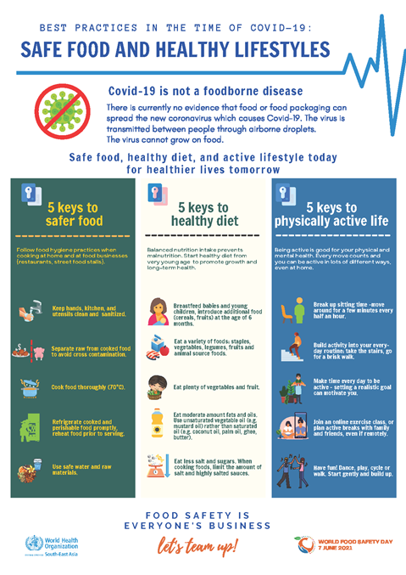

Slide 17
Some notes
food insecure != undernourished? (SG only has food insecure data instead of undernourished)
Unit is in million, which is quite unfair due to different number of population across countries
Dataviz ideas:
we can show several separate maps on the undernourished population and the food price inflation (would it be overwhelming?)
Q: how do we show its correlation?
Isn’t correlation a strong word? How do we prove that they both, indeed, correlate with each other?

Slide 18
References
FAO. 2022. FAOSTAT: unnourished people. In: FAO. Rome. Cited March 2022. https://www.fao.org/faostat/en/#data/FS
FAO. 2022. FAOSTAT: Consumer Price Indices. In: FAO. Rome. Cited March 2022. https://www.fao.org/faostat/en/#data/CP
Gustafson, S., Glauber, J., Hernández, M., Laborde, D. & Vos R. 2021. Rising Food Prices Are a Concern but No Reason for Panic Yet. In: IFPRI. Washington, D.C. Cited March 2022. https://www.ifpri.org/blog/rising-food-prices-are-concern-no-reason-panic-yet
IMF. 2021. World Economic Outlook: Recovery During a Pandemic. Health Concerns, Supply Disruptions. Washington, D.C. https://www.imf.org/en/Publications/WEO/Issues/ 2021/ 10/12/worldeconomic-outlook-october-2021
Kalish, I. & Wolf, M. 2022. Global surge in inflation. In: Deloitte. London. Cited March 2022. https://www2.deloitte.com/global/en/insights/economy/is-the-global-surge-in-inflation-here-to-stay.html
OECD. 2022. OECD Consumer Price Index News Release: November 2021. Paris. https://www.oecd.org/sdd/prices-ppp/consumer-prices-oecd-01-2022.pdf
Vos, R., Glauber, J., Hernández, M., & Laborde, D. 2022. COVID-19 and food inflation scares. In: J.

